Slide 1







FOR A BETTER TOMORROW
Meet Our Team
Karthick Raja
Nemaleshwar
Oswald Shilo
Jai Surya
UI/UX Designer
Backend Developer
Frontend Developer
ML Engineer

Slide 2
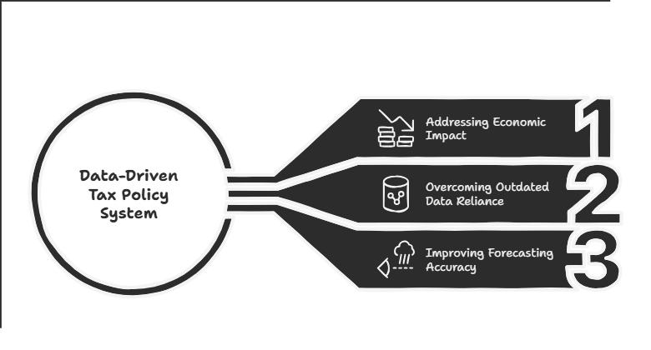

Problem Statement
To build a data-driven tax policy evaluation system that addresses unstable economic impact by analyzing multiple factors in real-time.
This system aims to overcome reliance on outdated data and improve forecasting accuracy for effective policymaking.
Constraints
Significance
Uncertain Policy Impact → ML enables precise tax policy forecasting.
Lack of Real-Time Insights → Simulations allow proactive policy evaluation.
GDP Volatility → Scalable models adapt to evolving economies.
Data-Driven – ML enhances tax policy forecasting.
Proactive Evaluation – Simulations refine policies pre-implementation.
Scalable & Adaptive – Adjusts to diverse and evolving economies.

Slide 3
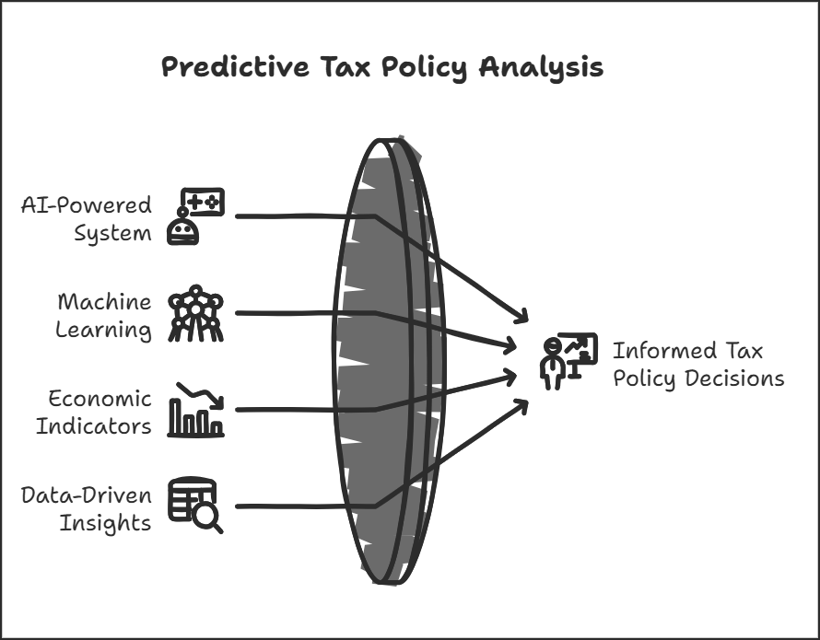
Our Solution
Taxonomist is an AI-powered tax policy evaluation system that leverages machine learning to predict the economic impact of tax policies.
It provides data-driven insights by analyzing multiple economic indicators, allowing policymakers to make informed, proactive decisions.
Key Features
Tax Policy Simulation – Predicts the impact of tax changes on GDP and economic stability.
ML-Driven Analysis – Uses machine learning to evaluate policy effectiveness.
Real-Time Insights – Allows dynamic testing and refinement of tax policies.
Scalable & Adaptive – Works across different economies and evolving financial landscapes.

Slide 4
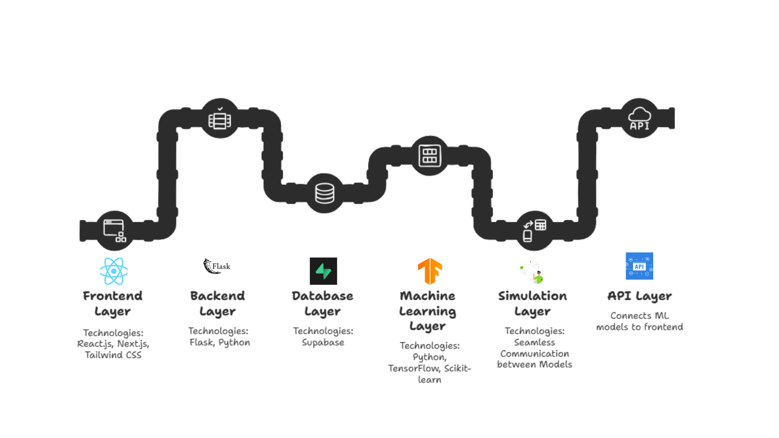
Tech Stack

Slide 5
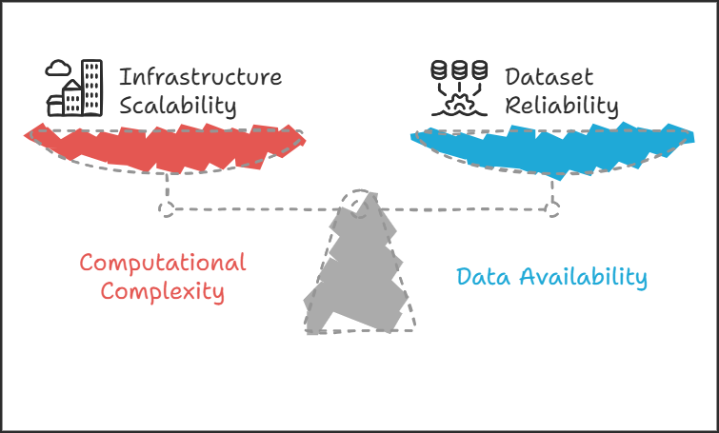
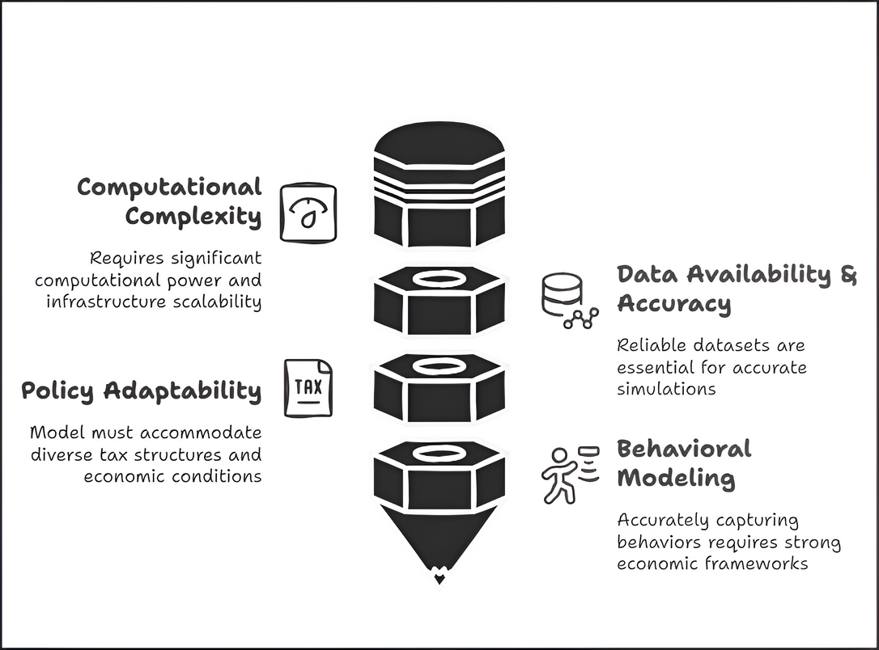
Feasability
Challenges
Computational Complexity – Implementing ABM requires significant computational power. Ensuring infrastructure scalability is key.
Data Availability & Accuracy – Reliable datasets for tax, economic, and behavioral modeling are essential for accurate simulations.
Policy Adaptability – The model must accommodate diverse tax structures and economic conditions across regions.
Behavioral Modeling – Capturing taxpayer, corporate, and consumer behaviors accurately requires strong behavioral economic frameworks.
Scalablity
Adaptable to different regions and tax laws.
Can integrate with government tax systems for real-time policy testing.
Expandable to include additional economic parameters and global markets.

Slide 6
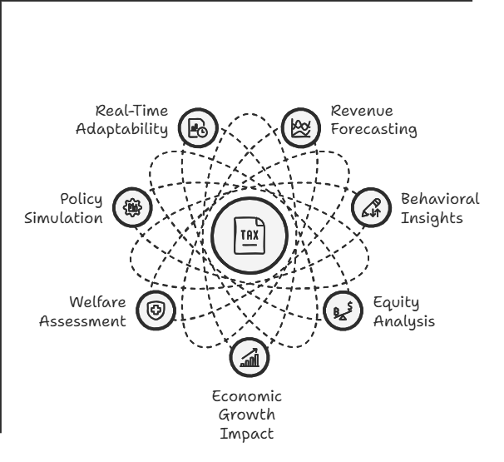
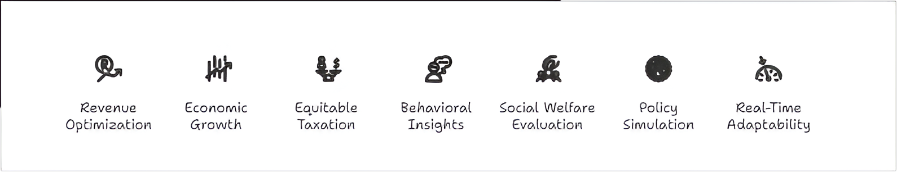
Impact & Benefits
Predicts Revenue Outcomes – Estimates tax revenue based on policy changes and compliance rates.
Assesses Taxpayer Behavior – Analyzes how individuals and businesses respond to tax policies.
Optimizes Fiscal Policies – Helps refine tax strategies for economic stability and growth.
Supports Equitable Taxation – Ensures fair distribution of tax burdens across income groups.
Enhances GDP Growth – Evaluates the impact of tax policies on economic expansion.
Evaluates Social Welfare – Measures effects on healthcare, education, and social mobility.

Slide 7
